Slide 1
Series
Rakib Mahmud

Slide 2
Series
Series are number sequences formed by applying specific rules and patterns to the numbers.
They can be increased or decreased depending on the operation used to create them.
A sequence 1, 2, 3, 4, ...., n is an increasing sequence obtained by adding 1 to the previous number.

Slide 3
Series Program: Flowchart 1+2+3+4+5+…+N
Start
Input n
Sum = 0
i = 1
False
i<=n
Print sum
True
End
Sum = Sum+i
i = i + 1

Slide 4
Series Program: Algorithm 1+2+3+4+5+…+N
Start
Input n
Sum=0, i=1
while i<=n
Repeat step 5
Sum = Sum+i, i = i+1
Print sum
end

Slide 5
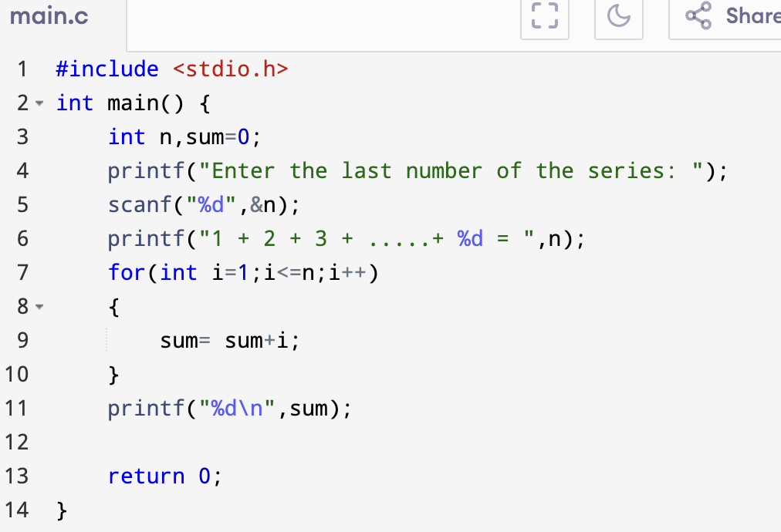
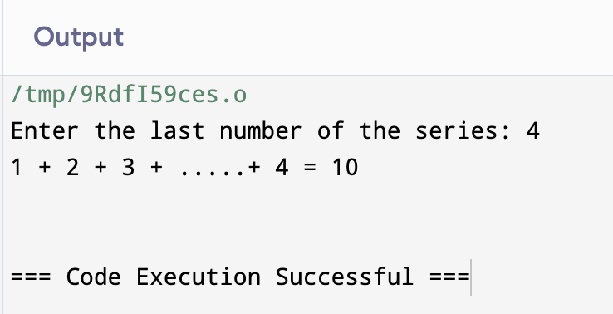
Series Program: Sum of Series in C 1+2+3+4+5+…+N

Slide 6
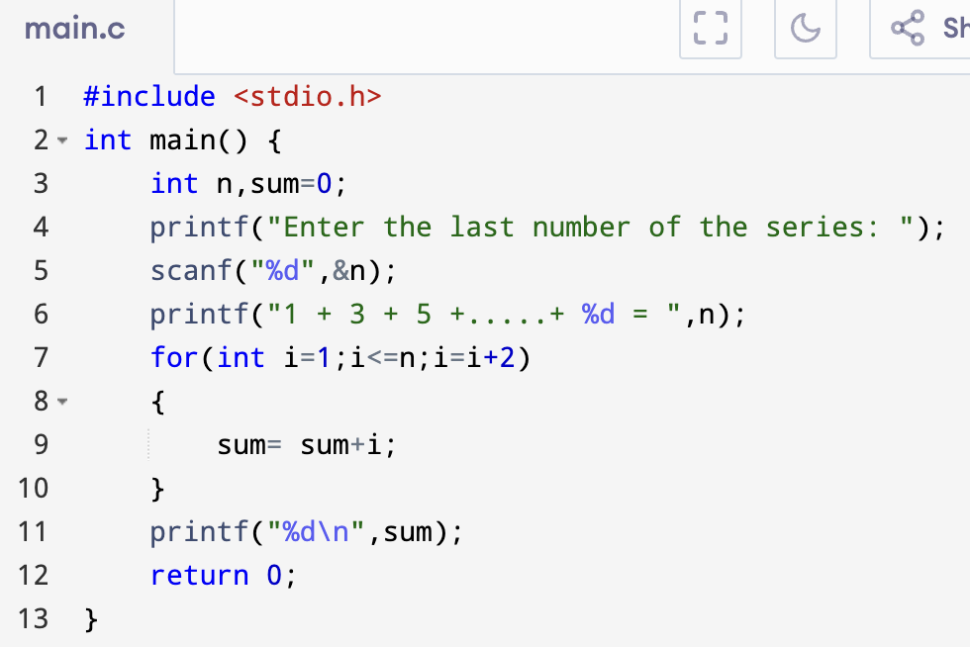
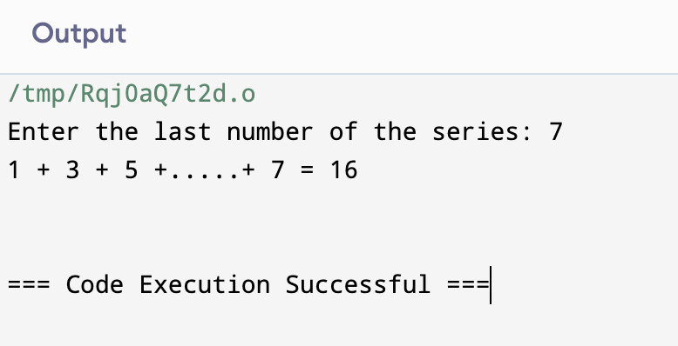
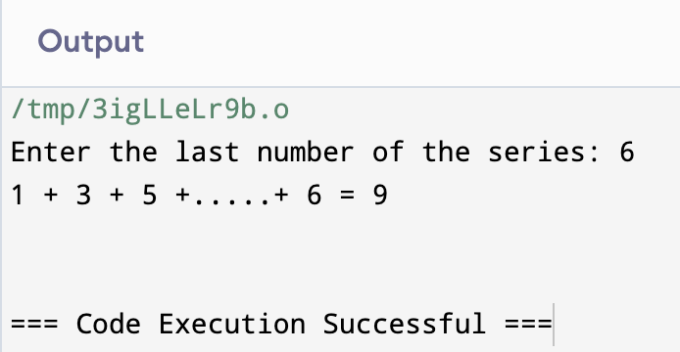
Series Program: Sum of Series in C 1+3+5+…+N

Slide 7
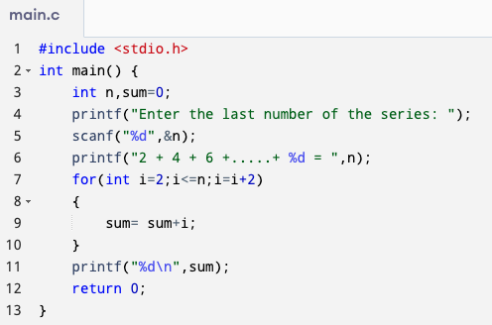
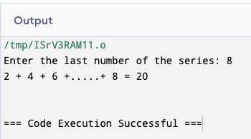
Series Program: Sum of Series in C 2+4+6+…+N

Slide 8
Series Program: Flowchart 1*2 + 2*3 + 3*4 +…+ N₁*N₂
Start
Input n1, n2
Sum = 0,
a= 1, b=2
a<=n1 && b<=n2
False
Print sum
True
End
Sum = Sum+a*b
a = a+1, b= b+1

Slide 9
Series Program: Algorithm 1*2 + 2*3 + 3*4 +…+ N₁*N₂
Start
Input n1, n2
Sum=0, a=1, b=2
while a<=n1 AND b<=n2:
Repeat step 5
Sum = Sum+a*b, a = a+1, b= b+1
Print sum
end

Slide 10
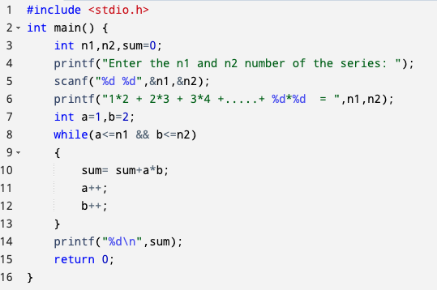
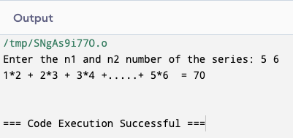
Series Program: Sum of Series in C 1*2 + 2*3 + 3*4 +…+ N₁*N₂

Slide 11
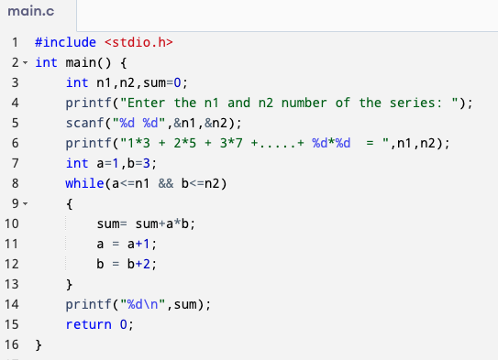
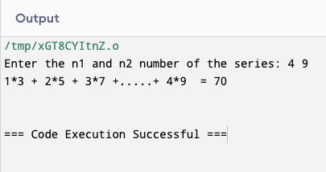
Series Program: Sum of Series in C 1*3 + 2*5 + 3*7 +…+ N₁*N₂

Slide 12
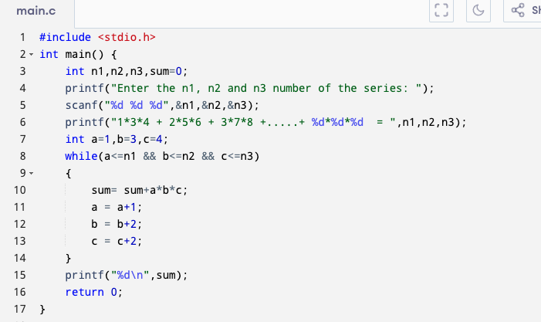
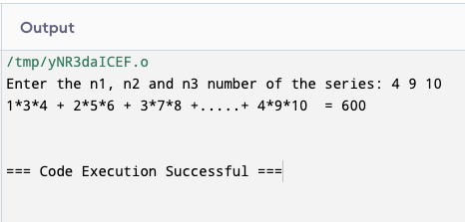
Series Program: Sum of Series in C 1*3*4 + 2*5*6 + 3*7*8 +…+ N₁*N₂*N₃

Slide 13
Series Program: Flowchart 1²+2²+3²+4²+5²+…+N²
Start
Input n
Sum = 0
i = 1
False
i<=n
Print sum
True
Sum = Sum+ pow(i,2)
End
i = i + 1

Slide 14
Series Program: Algorithm 1²+2²+3²+4²+5²+…+N²
Start
Input n
Sum=0, i=1
while i<=n
Repeat step 5
Sum = Sum+pow(i,2), i = i+1
Print sum
end

Slide 15
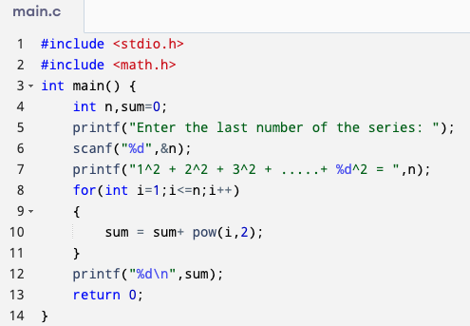
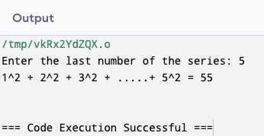
Series Program: Sum of Series in C 1²+2²+3²+4²+5²+…+N²

Slide 16
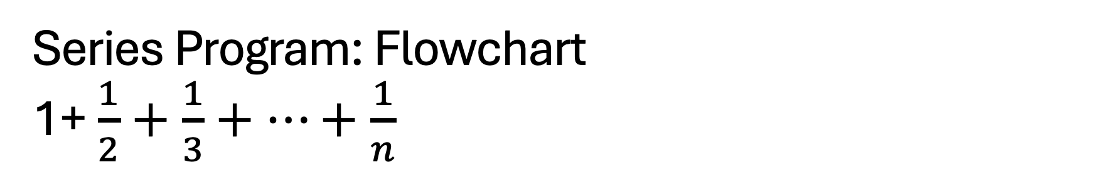
Series Program: Flowchart 1+ $\frac{1}{2}+\frac{1}{3}+…+\frac{1}{n}$
Start
Input n
Sum = 0
i = 1
False
i<=n
Print sum
True
Sum = Sum+(1.0/i)
End
i = i + 1

Slide 17
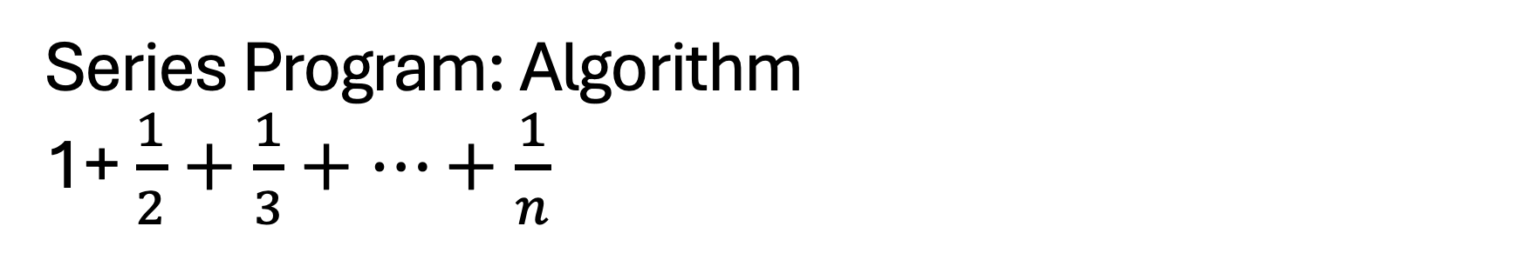
Series Program: Algorithm 1+ $\frac{1}{2}+\frac{1}{3}+…+\frac{1}{n}$
Start
Input n
Sum=0, i=1
while i<=n
Repeat step 5
Sum = Sum+(1.0/i), i = i+1
Print sum
end

Slide 18
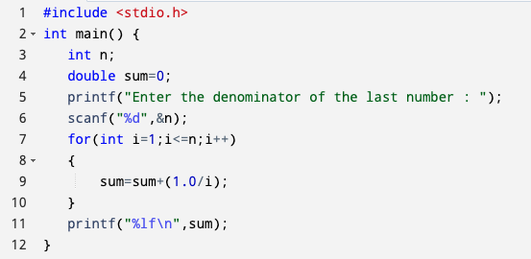
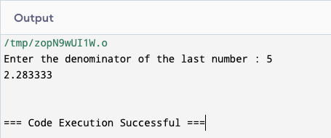
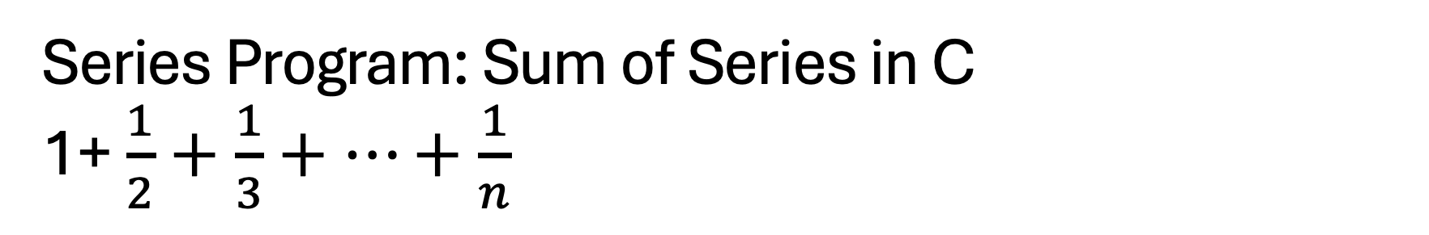
Series Program: Sum of Series in C 1+ $\frac{1}{2}+\frac{1}{3}+…+\frac{1}{n}$

Slide 19
Series Program: Flowchart 1*2*3*4*5*…*N
Start
Input n
Sum = 1
i = 1
False
i<=n
Print sum
True
End
Sum = Sum*i
i = i + 1

Slide 20
Series Program: Algorithm 1*2*3*4*5*…*N
Start
Input n
Sum=1, i=1
while i<=n
Repeat step 5
Sum = Sum*i, i = i+1
Print sum
end

Slide 21
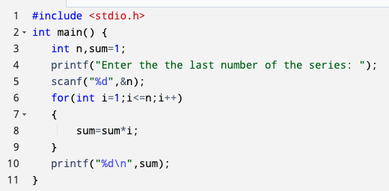
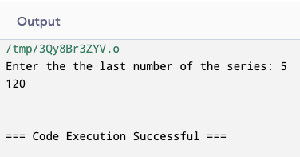
Series Program: Sum of Series in C/ Factorial of a number (1*2*3*4*5*…*N)

Slide 22
Series Program: Flowchart 1² * 2² * 3² * 4² * 5² *…* N²
Start
Input n
Sum = 1
i = 1
False
i<=n
Print sum
True
Sum = Sum* pow(i,2)
End
i = i + 1

Slide 23
Series Program: Algorithm 1² * 2² * 3² * 4² * 5² *…* N²
Start
Input n
Sum=1, i=1
while i<=n
Repeat step 5
Sum = Sum*pow(i,2), i = i+1
Print sum
end

Slide 24
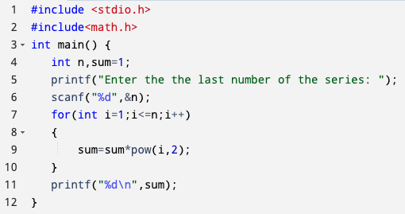
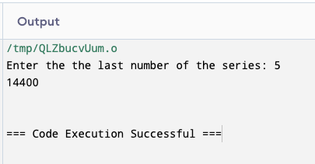
Series Program: Sum of Series in C 1² * 2² * 3² * 4² * 5² *…* N²

Slide 25
Series Program: Flowchart 1-2+3-4+5-…+N
Start
Input n
even =0, odd =0
sum =0, i = 1
False
i<=n
sum = odd-even
True
i%2==0
False
Print sum
True
even = even+i
odd = odd+i
End
i = i + 1

Slide 26
Series Program: Algorithm 1-2+3-4+5-…+N
Start
Input n
sum=0, even=0, odd=0, i=1
while i<=n
Repeat step 5
Is i%2==0:
Yes, even = even + i
No, odd = odd + i
sum = odd - even
Print sum
end

Slide 27
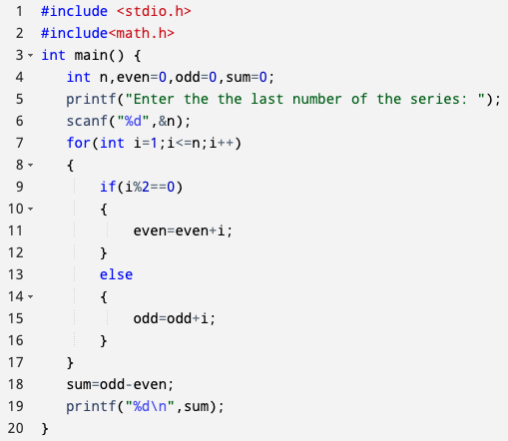
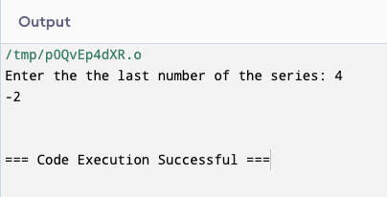
Series Program: Sum of Series in C 1-2+3-4+5-…+N

Slide 28
Flowchart to Print Fibonacci Series 0 1 1 2 3 5 8 ……..
Start
Input n
first = 0, second =1,
fibo =0, i = 1
i<=n
False
End
True
True
i==1
Print first
False
True
i==2
Print second
False
fibo=first+second
Print fibo
first = second
second = fibo
i = i + 1

Slide 29
Algorithm to Print Fibonacci Series 0 1 1 2 3 5 8 ……..
Start
Input n
first = 0, second =1, fibo =0, i = 1
while i<=n
Repeat step 5 to 9
Is i==1:
Yes, print first
No, go to next step
Is i==2:
Yes, print second
No, go to next step
fibo=first+second
Print fibo
first=second, second= fibo
end

Slide 30
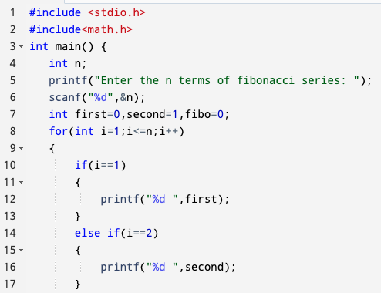
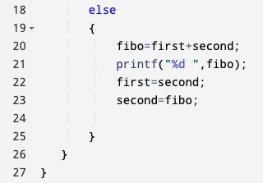
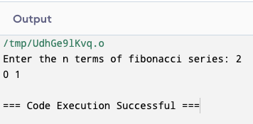
C Program to Print Fibonacci Series 0 1 1 2 3 5 8 ……..

Slide 31
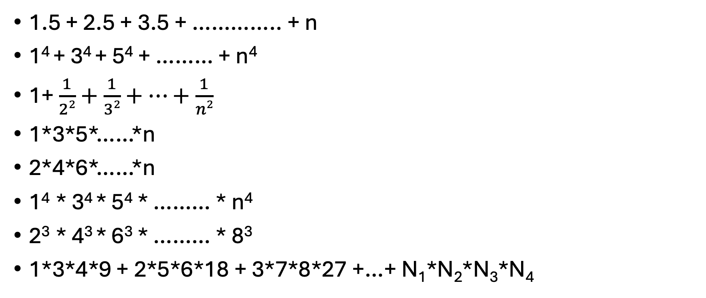
Exercises:
1.5 + 2.5 + 3.5 + ………….. + n
1⁴ + 3⁴ + 5⁴ + ……… + n⁴
1+ $\frac{1}{22}+\frac{1}{32}+…+\frac{1}{n2}$
1*3*5*……*n
2*4*6*……*n
1⁴ * 3⁴ * 5⁴ * ……… * n⁴
2³ * 4³ * 6³ * ……… * 8³
1*3*4*9 + 2*5*6*18 + 3*7*8*27 +…+ N₁*N₂*N₃*N₄

Slide 32
Thank You

